Slide 1


DieHarder: Securing the Heap
Gene Novark & Emery Berger
University of Massachusetts, Amherst
[originally presented at CCS 2011]

Slide 2

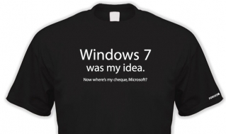
DieHard: Probabilistic Memory Safety for C/C++ Programs [PLDI 2005]
Direct inspiration for Windows 7’s Fault-Tolerant Heap (2009)
Notes:
Before DieHarder, there was DieHard. Goal was fault tolerance; incorporated in Windows 7, but…

Slide 3
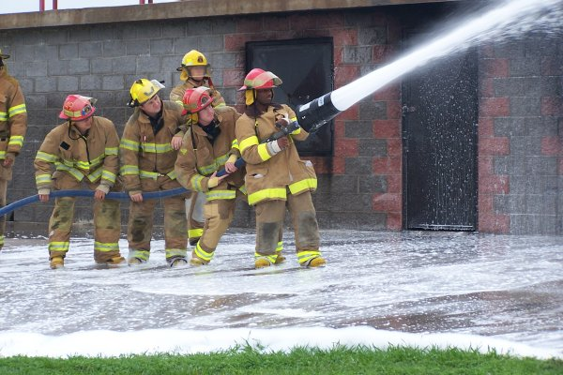

DieHard: Probabilistic Memory Safety for C/C++ Programs [PLDI 2005]
Direct inspiration for Windows 7’s Fault-Tolerant Heap (2009)
Notes:
SEVERELY watered down. Adopted many of features that make DieHard resilient to failure, and makes it fault tolerant, but

Slide 4
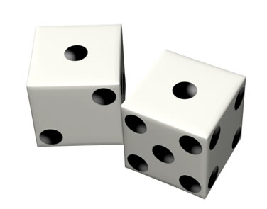
Notes:
DieHard uses randomization to provide probabilistic memory safety, but MS decided they didn’t want randomness

Slide 5
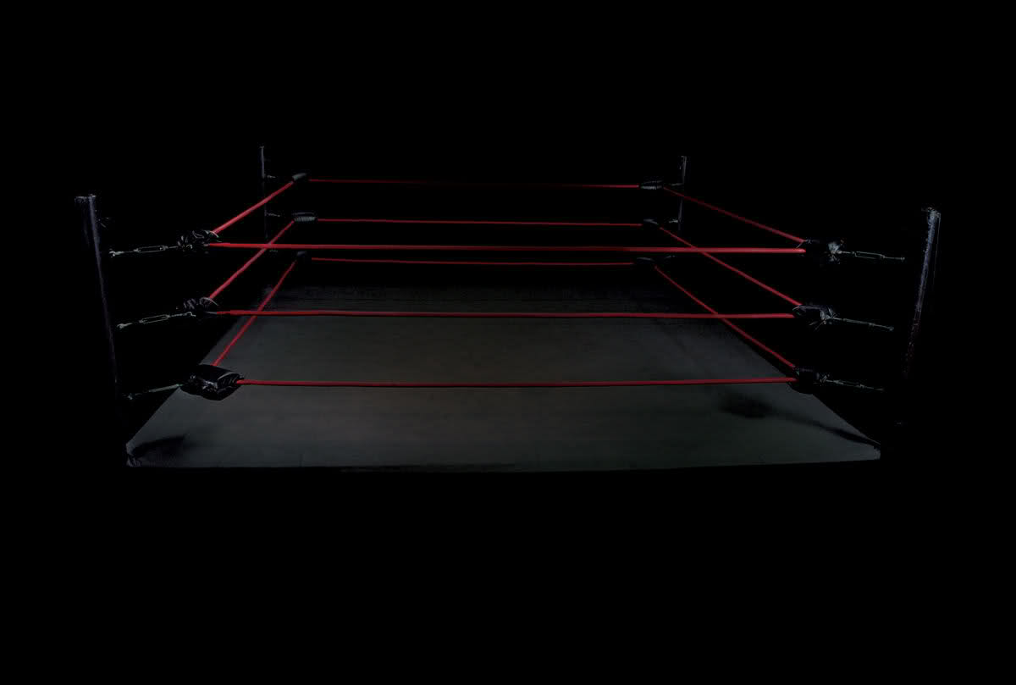

Notes:
Now planning for Windows 8. Fault tolerant vs. secure. Randomness needed?

Slide 6
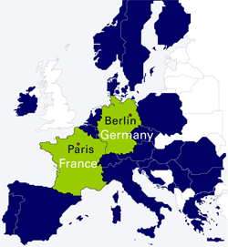

Slide 8


Slide 14
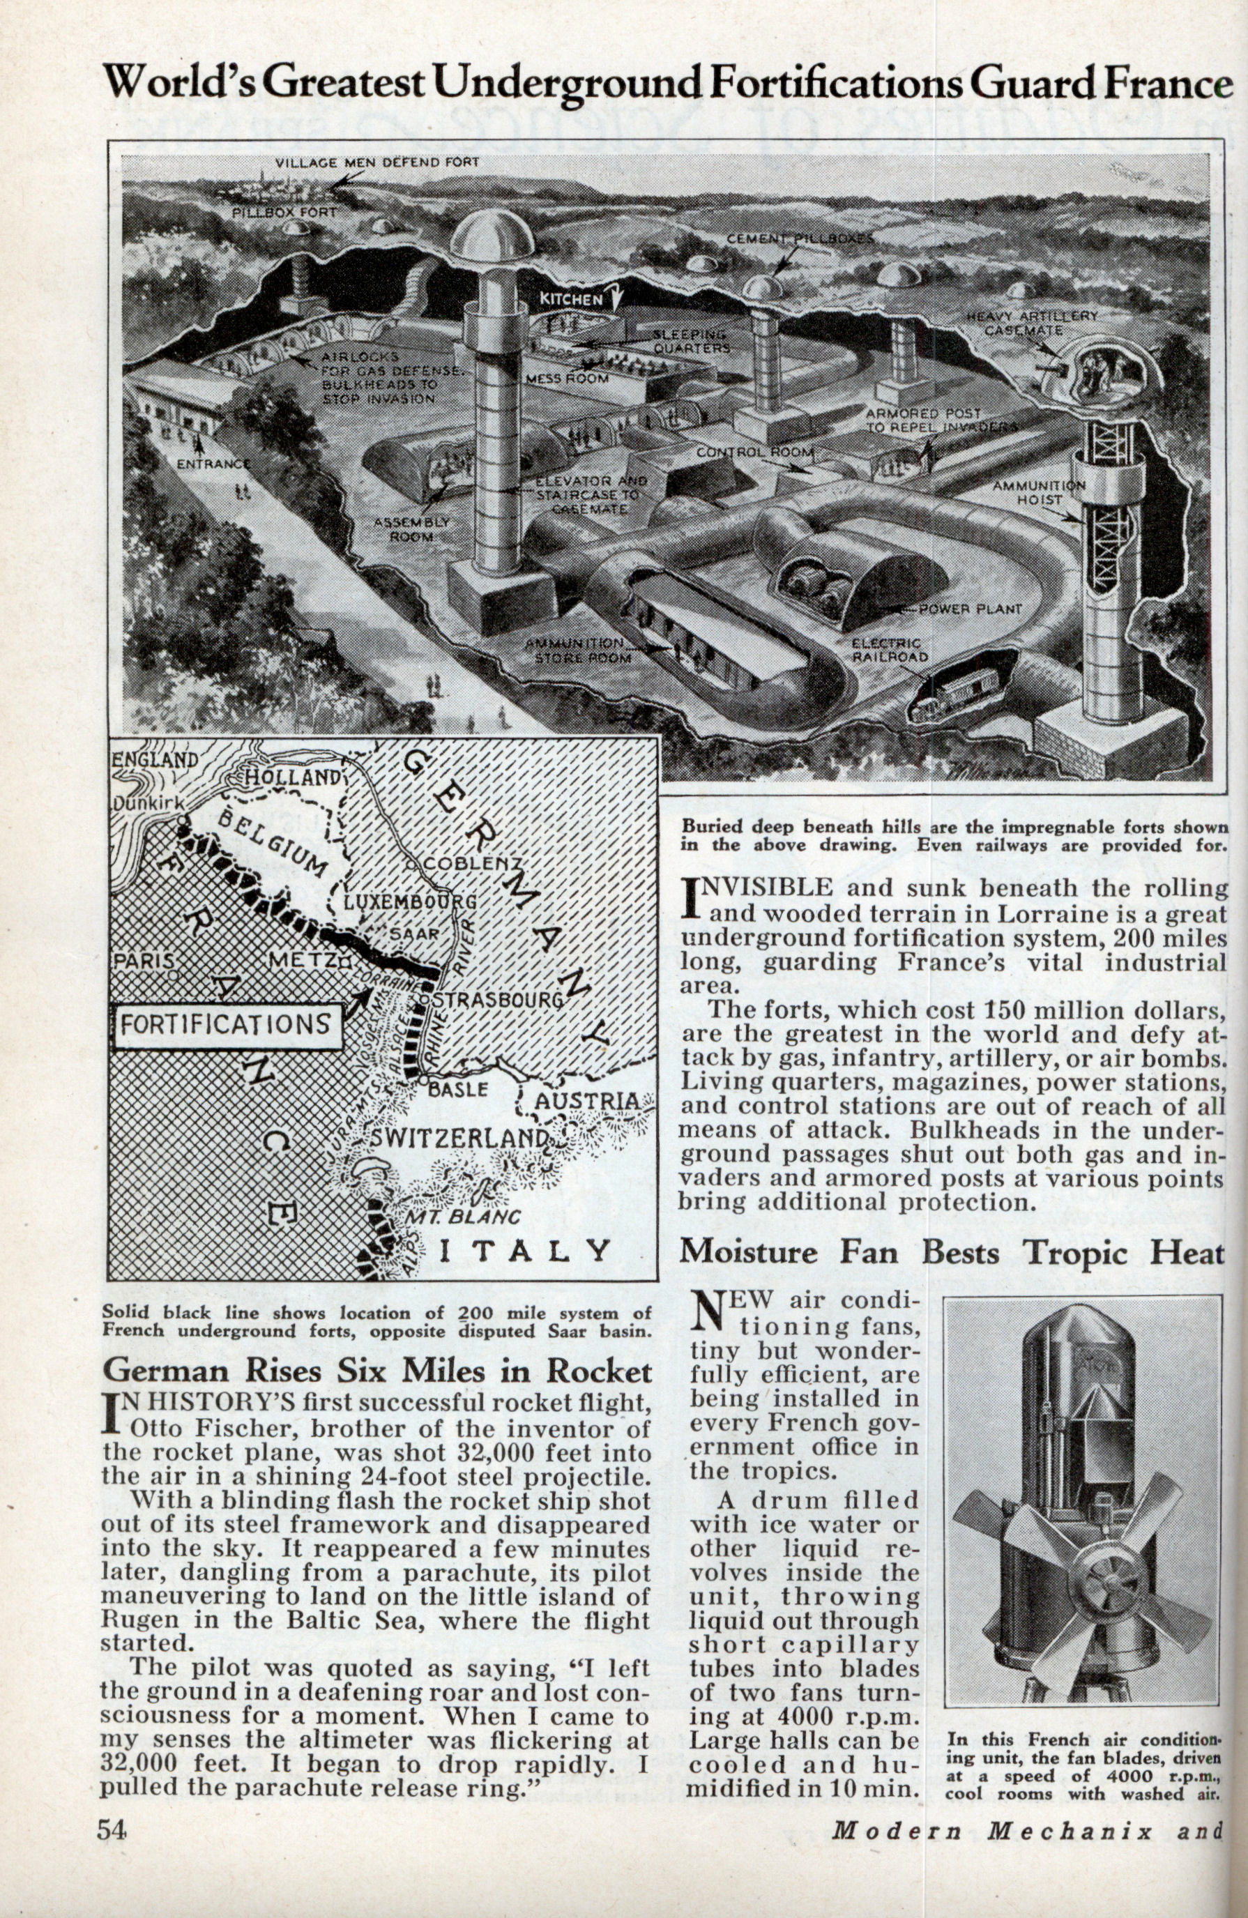

Slide 15
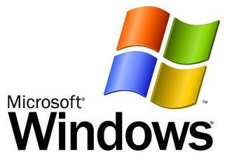
Notes:
I mean, Windows

Slide 18
Notes:
So the big question between counterattacks & the next attack is…

Slide 19

Notes:
So the big question between counterattacks & the next attack is…

Slide 20
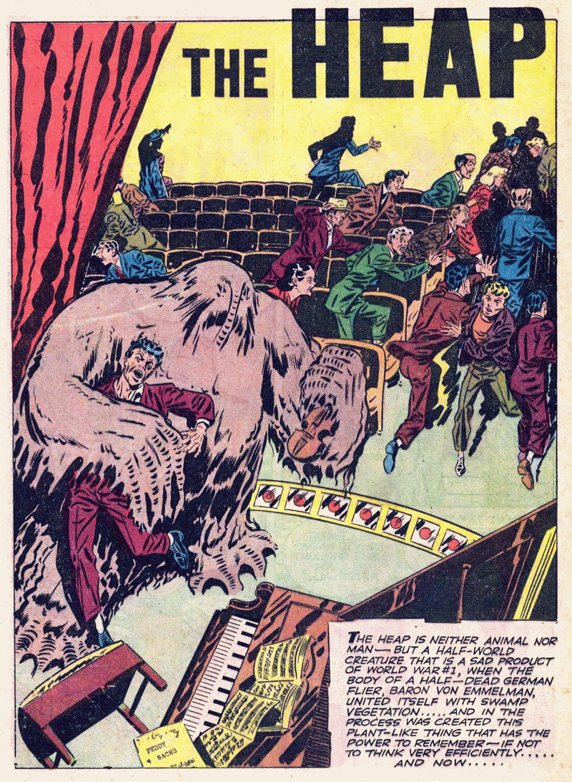
Notes:
Today we are focusing on the heap – a clear threat

Slide 21
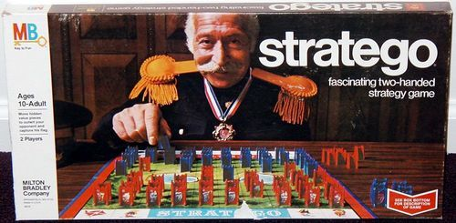
Notes:
Rather than talk technical about the heap internals - stratego

Slide 22
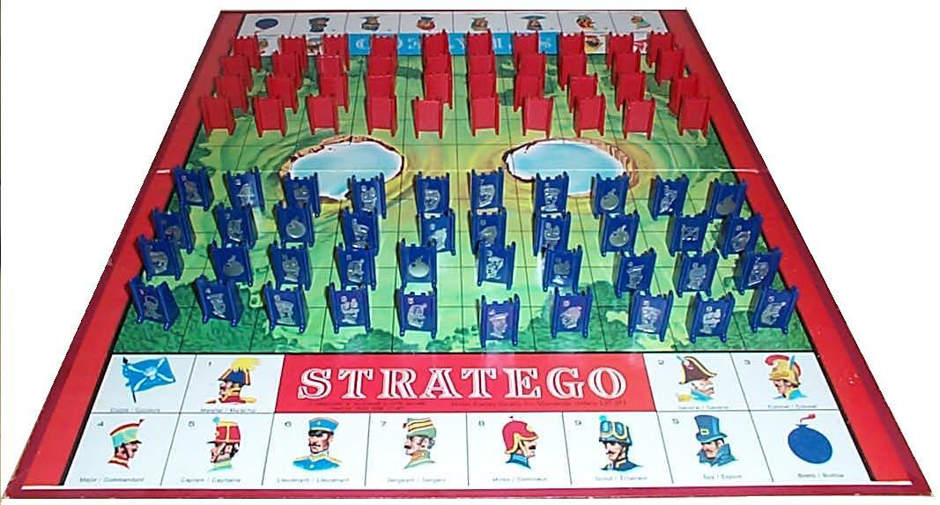
Notes:
If you haven’t played, here’s the way it works…

Slide 23
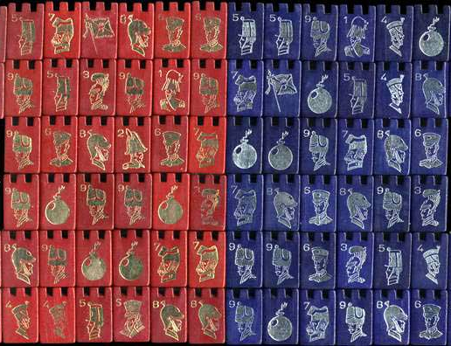
Notes:
There are lots of pieces in the original game…

Slide 24
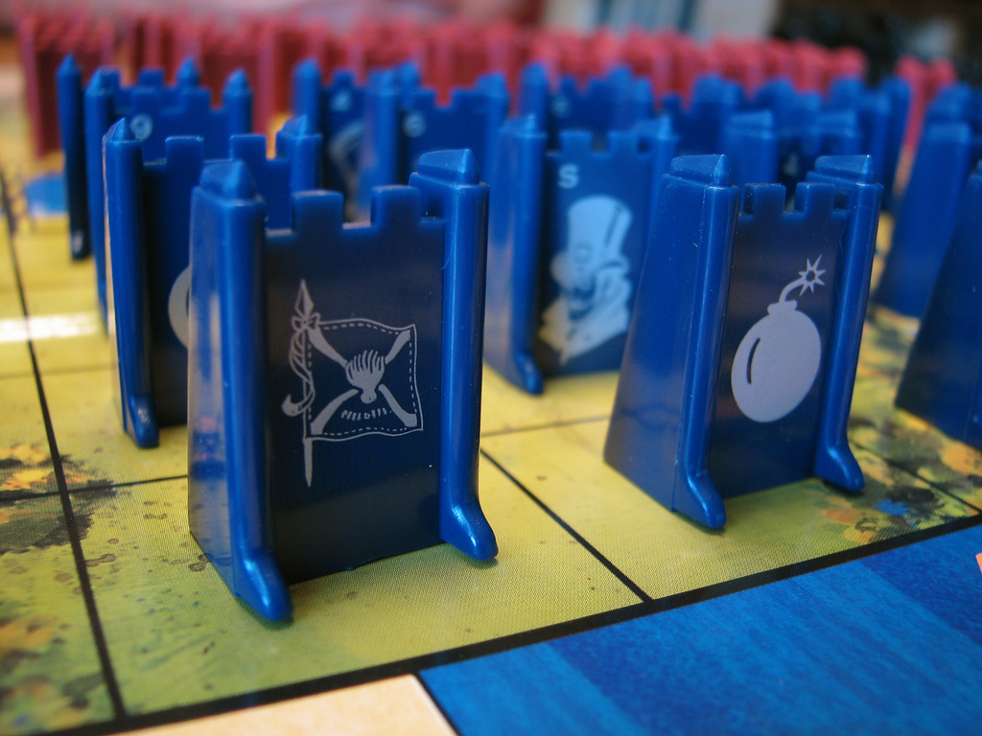
Notes:
But in this talk, we’re going to pretend that the only pieces are flags and bombs. If you hit a flag, you win. If you hit a bomb, you die.

Slide 25
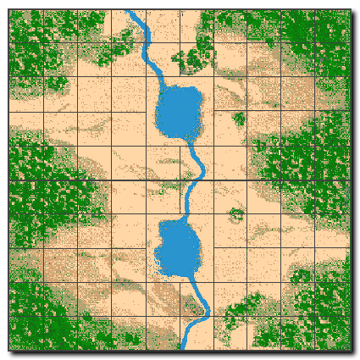
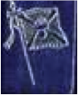
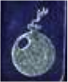
Notes:
Suppose this is the board layout.

Slide 26
Notes:
If the attacker hits the flag, …

Slide 27
Notes:
Pwned.

Slide 28
Notes:
However…

Slide 29
Notes:
If he hits the bomb...

Slide 30
Notes:
Then “the good guys” win.

Slide 31
Notes:
So to be concrete…

Slide 32
sensitive data / metadata
Notes:
The flags are sensitive data or metadata.

Slide 33
sensitive data / metadata
All data / metadata sensitive
Notes:
In our model, we assume conservatively that *all* data / metadata is sensitive.

Slide 34
guard / unmapped page
Notes:
And each bomb is either a guard page (mprotected) or an unmapped page, so a write or read into this space…

Slide 35
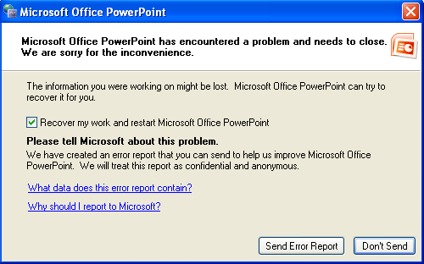
guard / unmapped page
Notes:
Does this.

Slide 36

Notes:
This is how it works for Windows

Slide 37
Notes:
This is how it works for Windows

Slide 38
Notes:
This is how it works for Windows

Slide 39
Address-space layout randomization
Notes:
This is how it works for Windows

Slide 40
object
free space
heap metadata

Slide 41
prev. object
object size
object
free space
heap metadata
(GNU libc, others)

Slide 42
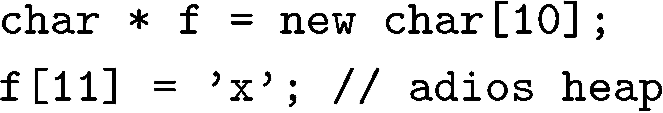
object
x
free space
heap metadata

Slide 43
object
x
free space
heap metadata

Slide 44
Notes:
This is how it works for Windows

Slide 45
Notes:
This is how it works for Windows

Slide 46
Notes:
This is how it works for Windows

Slide 47

Notes:
This is how it works for Windows

Slide 48
Notes:
This is how it works for Windows

Slide 49
Notes:
This is how it works for Windows

Slide 50
Notes:
This is how it works for Windows

Slide 51
≈ 4-5 bits of entropy
Notes:
This is how it works for Windows

Slide 52
DIE HARDER
Notes:
This is how it works for Windows

Slide 53
Maximal entropy: log N bits (e.g., ≈ 25-30)
DIE HARDER
Notes:
This is how it works for Windows

Slide 54
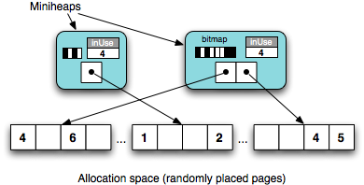

Slide 55
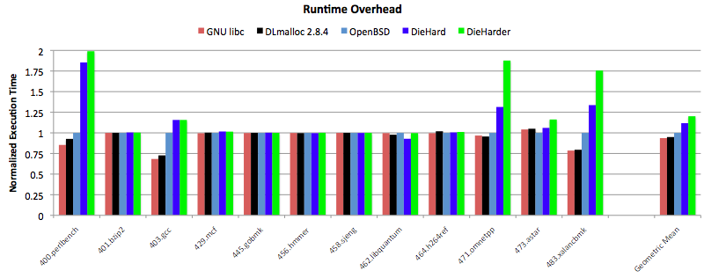

Slide 56

DIE HARDER

Slide 57
44.2 sec
DIE HARDER

Slide 58
44.2 sec
41.6 sec
DIE HARDER

Slide 59
DieHarder: Securing the Heap
Gene Novark & Emery Berger
University of Massachusetts, Amherst

Slide 60
char * str = new char[8];
strcpy (str, “goodbye cruel world”);

Slide 61
int * v = new int[4];
…
delete [] v; // oops
…
char * str = new char[16];
strcpy (str, “die, pointer”);
v[3] = 12;
… use of v[0]

Slide 62
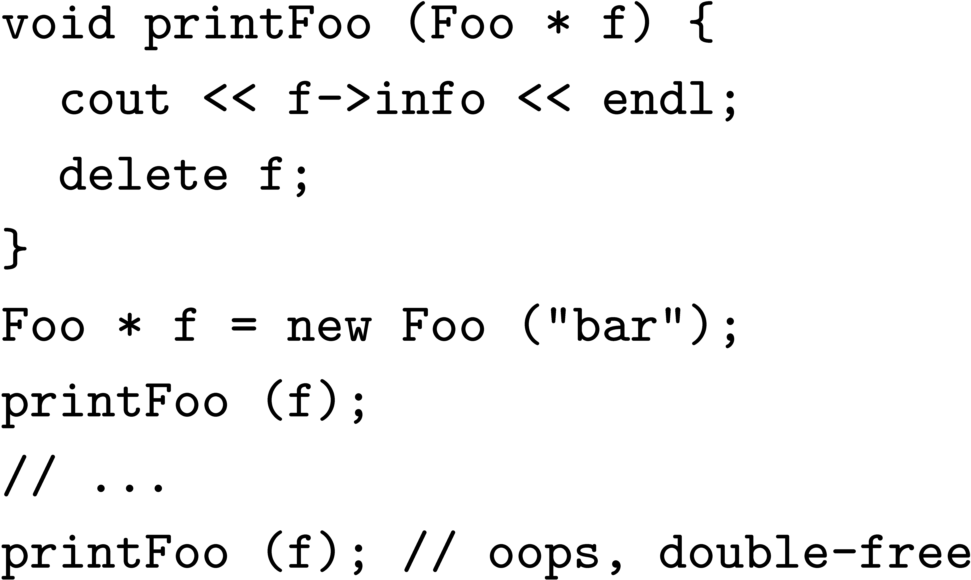
Double free

Slide 63
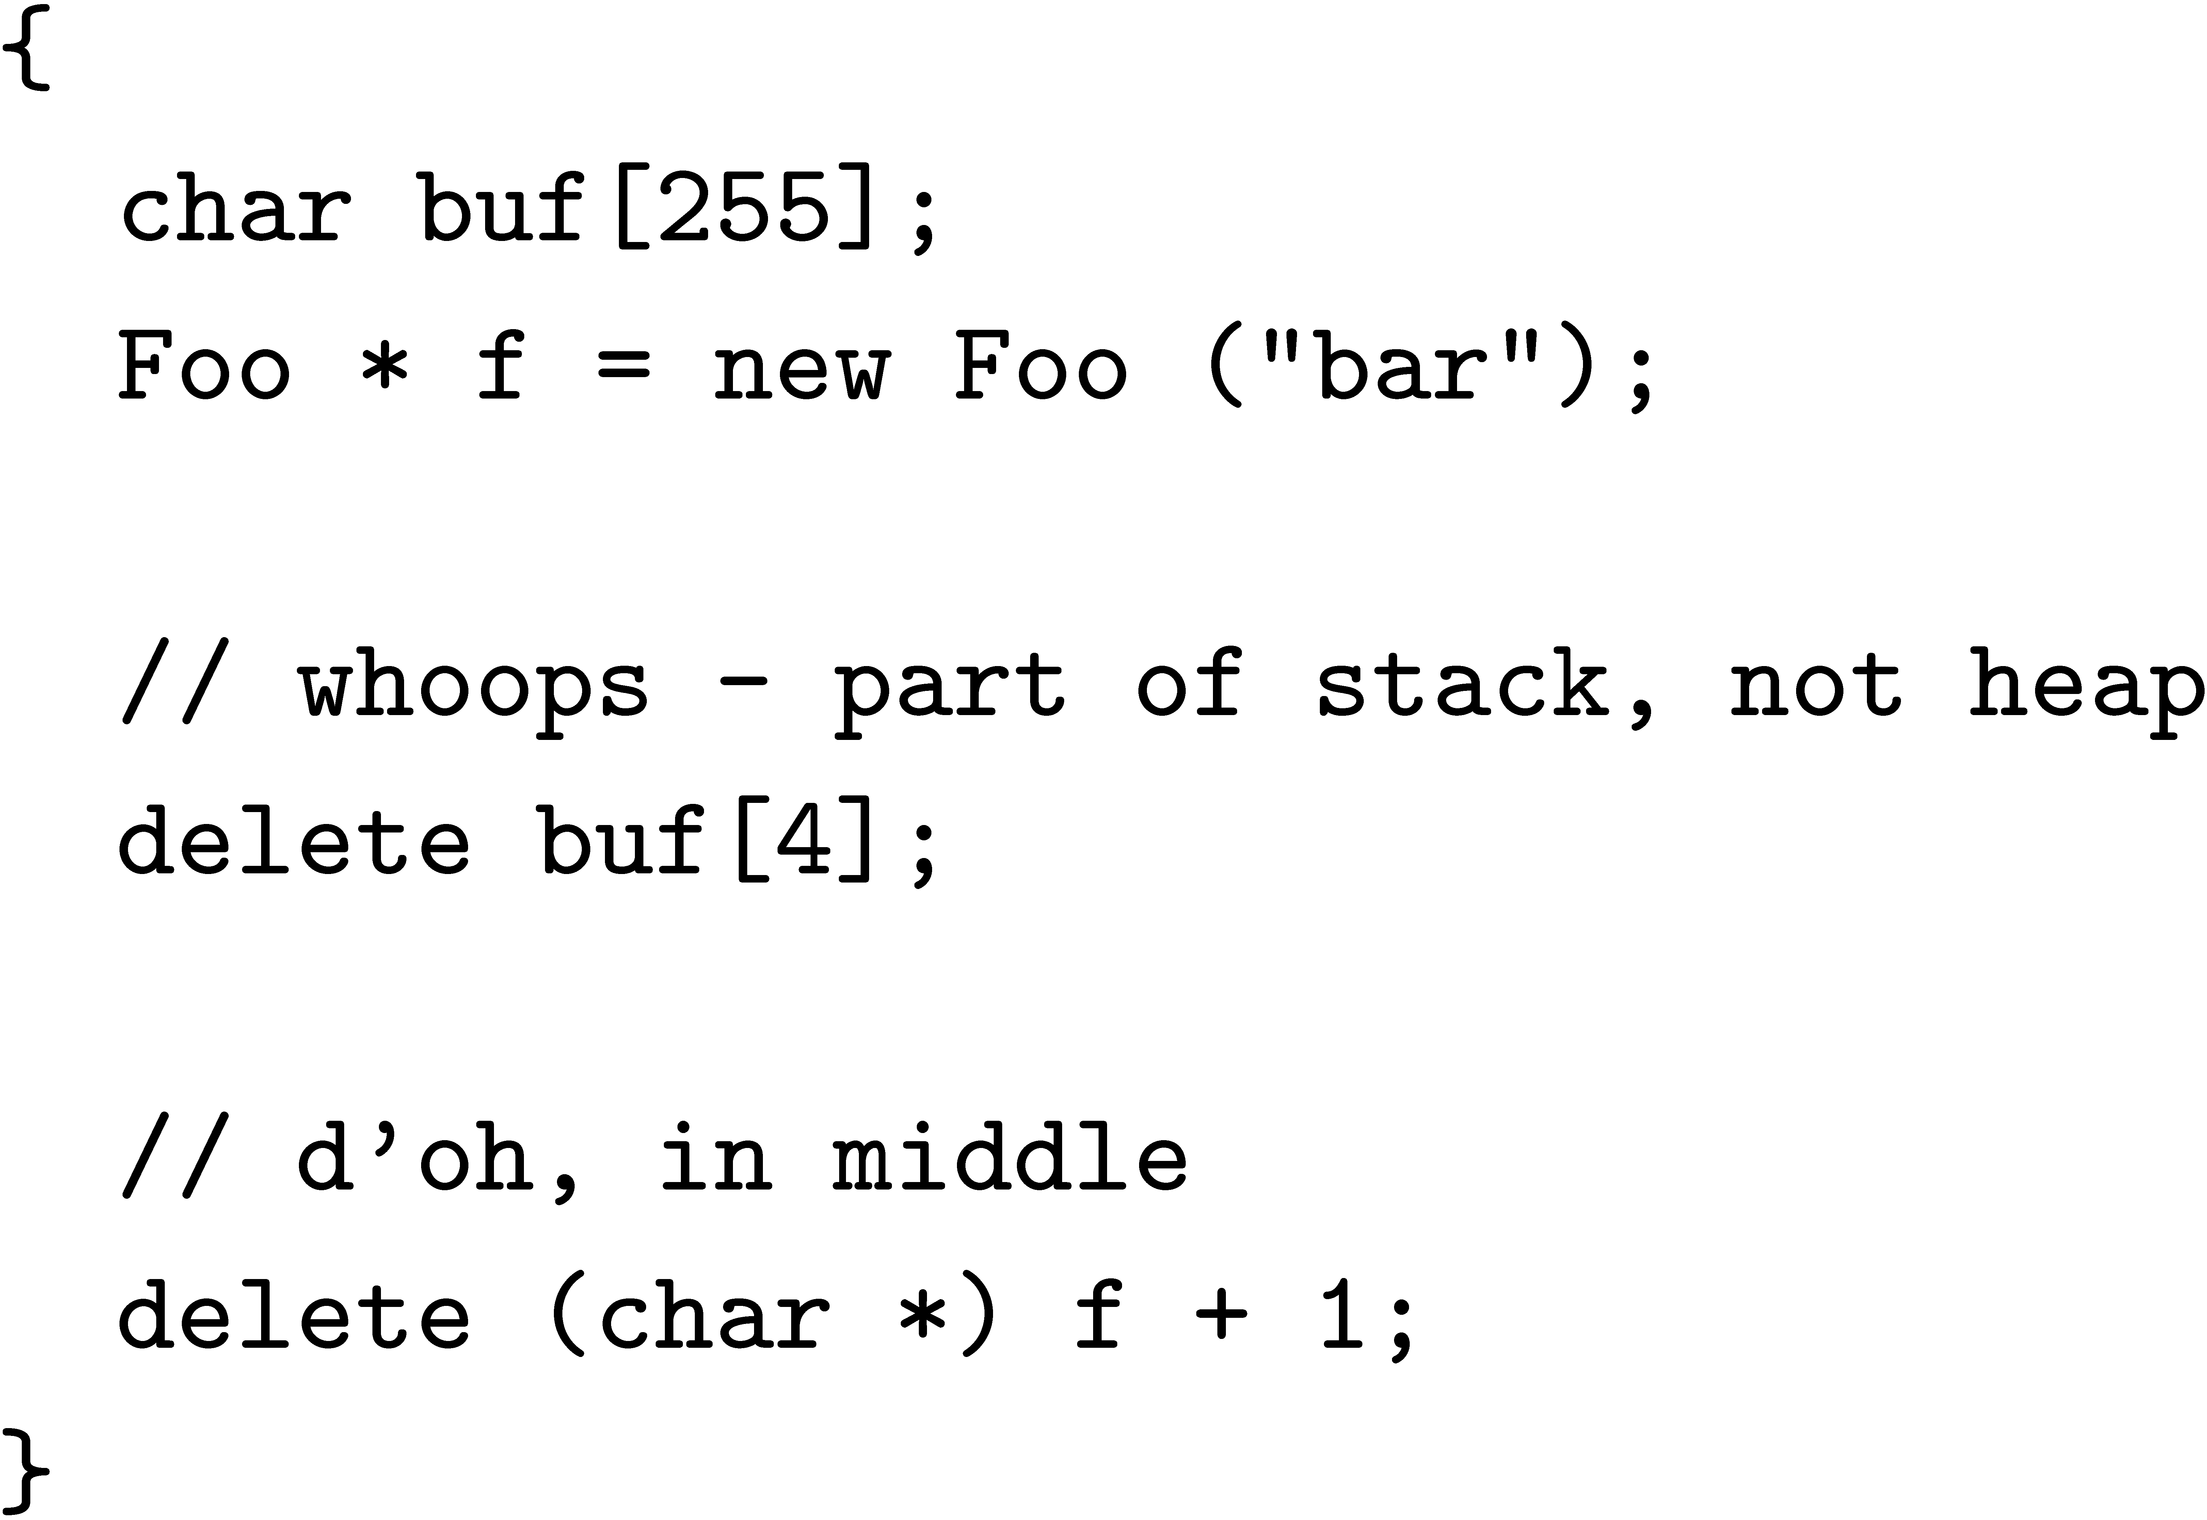
Invalid free

Slide 64
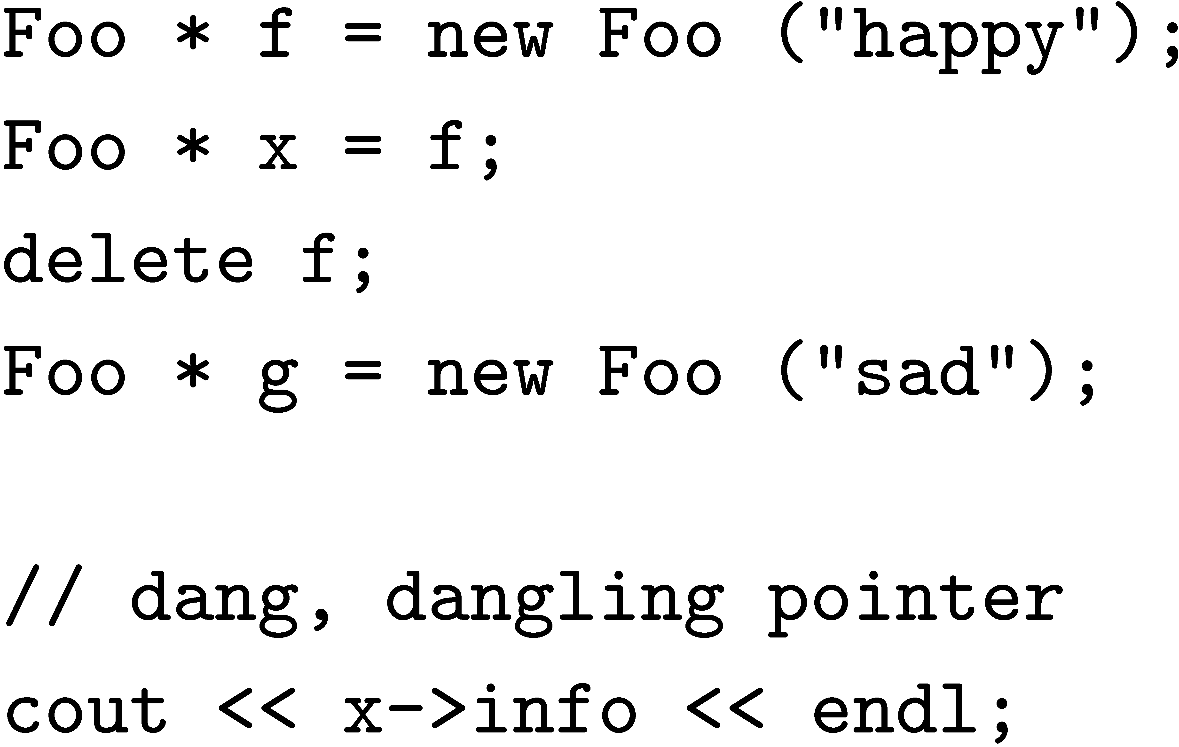
Dangling Pointer

Slide 65
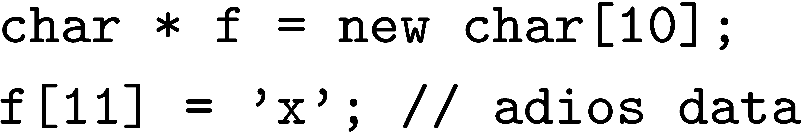
Buffer Overflows: Data Corruption
object
object
x
Bug corrupts application data

Slide 66
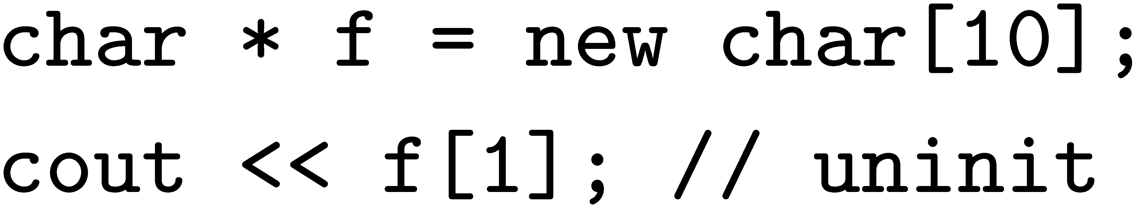
Uninitialized Reads
object
free space
C/C++ standard – undefined value

Slide 67
DieHard, heap layout
object size
allocation space
8
1
2
4
3
6
5
inUse
6
inUse
inUse
bitmap
2
4
16
1
inUse
miniheaps
1
inUse
1
Bitmap-based, segregated size classes
Bit represents one object of given size
i.e., one bit = 2^{i+3} bytes, etc.
malloc(): randomly probe bitmap for free space
free(): just reset bit

